Slide 1
Reversible Data Hiding in Encrypted Images
Based on Edge-Directed Prediction and
Multi-MSB Self-Prediction

Slide 2
INDEX
Abstract
Objective of project
Problem Statement
Scope & Motivation
Introduction
Literature survey
Existing Method
Disadvantages
Proposed method
Advantages
Project Flow
Hardware and Software Requirements
Architecture
Modules
UML Diagram
Output Screens
Conclusion
Future Work
References

Slide 3
ABSTRACT
This paper proposes a high-capacity reversible data hiding in encrypted images (RDH-EI) method that combines edge-directed prediction (EDP) and multi-MSB self-prediction. The system aims to securely embed additional data within encrypted grayscale images without compromising the original image quality. The proposed method involves two main participants: the data owner and the data user, with an admin responsible for authorizing user access. The data owner encrypts the image, while the data user can request the image and retrieve it only after OTP verification. The method utilizes advanced algorithms, such as MSB prediction and adaptive error embedding, to enhance data embedding capacity and improve encryption security. Experimental results demonstrate that the method achieves high embedding rates, security, and lossless image recovery, outperforming state-of-the-art RDH-EI techniques. This technique ensures confidentiality and integrity while providing a reversible process for image recovery and data extraction.
Keywords
Reversible Data Hiding, Encrypted Images, Edge-Directed Prediction, Multi-MSB Self-Prediction, Data Embedding, Image Encryption, Data Security, OTP Verification, Image Recovery, Reversible Data Hiding in Encrypted Domain (RDH-EI).

Slide 4
OBJECTIVE OF PROJECT
The objective of this project is to develop a high-capacity Reversible Data Hiding in Encrypted Images (RDH-EI) method that enables efficient embedding of additional data into encrypted grayscale images while ensuring the lossless recovery of the original image. The project aims to implement advanced data embedding techniques using Edge-Directed Prediction (EDP) and Multi-MSB Self-Prediction to enhance embedding capacity and accuracy. It also focuses on ensuring secure and reversible image recovery through encryption and data extraction processes. Furthermore, the project incorporates a user authorization system with OTP verification to prevent unauthorized access and maintain data privacy, ultimately achieving high embedding capacity without compromising image quality or security.

Slide 5
PROBLEM STATEMENT
As cloud storage and encrypted communication become more prevalent, ensuring the security and privacy of image data is crucial. Traditional data hiding methods cannot be applied to encrypted images due to the loss of spatial redundancy, limiting data embedding capacity. Existing Reversible Data Hiding in Encrypted Images (RDH-EI) techniques struggle with achieving high embedding capacity while ensuring secure, reversible image recovery. This work aims to develop a high-capacity, secure RDH-EI method that allows data embedding in encrypted images and guarantees lossless image recovery, with an effective user authorization system to prevent unauthorized access.

Slide 6
SCOPE AND MOTIVATION
Scope : The scope of this project encompasses the development of a high-capacity Reversible Data Hiding in Encrypted Images (RDH-EI) method that enables secure and efficient data embedding in encrypted grayscale images. It focuses on utilizing advanced prediction techniques like Edge-Directed Prediction (EDP) and Multi-MSB Self-Prediction to optimize embedding capacity while ensuring lossless image recovery. The project also integrates a robust user authorization system with OTP verification to prevent unauthorized access and safeguard data privacy. The solution is designed for applications in cloud storage and secure communication where both data security and image integrity are critical.

Slide 7
SCOPE AND MOTIVATION
With the rise of cloud computing and increasing concerns over data privacy, protecting sensitive data, especially in images, has become a major priority. Traditional data hiding techniques struggle with encrypted images due to the loss of spatial redundancy after encryption. Reversible Data Hiding in Encrypted Images (RDH-EI) addresses this challenge, allowing additional data to be embedded in encrypted images while ensuring the original image can be perfectly restored.
The motivation for this work is to enhance both the security and capacity of RDH-EI methods. By incorporating Edge-Directed Prediction (EDP) and Multi-MSB Self-Prediction, this method provides higher embedding capacity and greater accuracy compared to existing techniques. Additionally, the inclusion of an admin role for user authorization and OTP verification ensures that only authorized users can access and recover the original image, adding a layer of security critical for applications in fields like medical imaging and secure communications.
This approach aims to improve the efficiency, security, and reversibility of data hiding in encrypted images, contributing to the ongoing effort to safeguard sensitive data in cloud-based environments.

Slide 8
INTRODUCTION
With the growing reliance on cloud storage and encrypted communication for safeguarding sensitive data, ensuring the security and privacy of image files has become a significant concern. Traditional data hiding techniques, which embed additional data into images, are not suitable for encrypted images due to the loss of spatial redundancy caused by encryption. This limitation restricts the capacity to embed data while maintaining the original image quality.
Reversible Data Hiding in Encrypted Images (RDH-EI) has emerged as a solution to this problem, enabling the embedding of data within encrypted images while ensuring that the original image can be perfectly restored. However, existing RDH-EI methods face challenges in achieving high embedding capacity and maintaining secure, lossless recovery of the image.
This project aims to address these challenges by proposing a high-capacity RDH-EI method that leverages advanced techniques such as Edge-Directed Prediction (EDP) and Multi-MSB Self-Prediction. These techniques enhance the accuracy of pixel prediction and increase the available space for data embedding, ensuring both high embedding capacity and secure image recovery. Additionally, the project integrates a user authorization system with OTP verification to ensure that only authorized users can access and download the embedded data. The proposed method targets applications in cloud storage and secure communication where both data security and image integrity are crucial.

Slide 9
LITERATURE SURVEY
S. NO | Journal Type with year | Authors | Title | Outcomes
1 | 2025 | Fang Ren, Zhelin Zhang, Kai Jiang, Peiyang Zhang, Tengfei Yang | Reversible Data Hiding and Authentication Scheme for Encrypted Images Based on Prediction Error Compression | IThis paper proposes a scheme that combines reversible data hiding with content authentication. It utilizes a new predictor, ISGAP, to generate accurate predictions, compresses errors using adaptive Huffman coding, and embeds authentication information to ensure both data confidentiality and integrity..
2 | 2021 | Pauline Puteaux, Simying Ong, Koksheik Wong, William Puech | A Survey of Reversible Data Hiding in Encrypted Images | This comprehensive survey reviews the evolution of RDH-EI over the past 12 years, categorizing various techniques and highlighting significant methods that balance embedding capacity, security, and image quality

Slide 10
EXISTING METHOD
Existing Reversible Data Hiding in Encrypted Images (RDH-EI) systems primarily focus on embedding data into encrypted images while ensuring the original image can be accurately restored. However, these methods often face limitations in embedding capacity due to the loss of spatial redundancy after encryption. Techniques like Least Significant Bit (LSB) prediction and prediction-error expansion, though widely used, struggle to balance high embedding capacity with image quality and security. These methods also lack robust user authorization systems, leading to potential security risks, and often require substantial computational resources for data embedding and recovery.

Slide 11
DISADVANTAGES
Limited embedding capacity due to the loss of spatial redundancy after encryption.
Inability to maintain high image quality while embedding large amounts of data.
Lack of robust user authorization systems, leading to potential unauthorized access.
High computational complexity for data embedding and image recovery.
Security vulnerabilities in data extraction and recovery processes.

Slide 12
PROPOSED SYSTEM
The proposed system aims to enhance existing RDH-EI methods by using advanced techniques like Edge-Directed Prediction (EDP) and Multi-MSB Self-Prediction, which improve pixel prediction accuracy and increase the embedding capacity. Additionally, it integrates a user authorization system with OTP verification to ensure that only authorized users can access and download the embedded data, further securing the data. The proposed system ensures a higher embedding rate, improved image recovery, and enhanced security, making it more suitable for cloud storage and secure communication applications where both data integrity and confidentiality are essential.

Slide 13
ADVANTAGES
Improved embedding capacity using Edge-Directed Prediction (EDP) and Multi-MSB Self-Prediction.
Secure data embedding with lossless image recovery.
Integration of a user authorization system with OTP verification for enhanced security.
Higher accuracy in pixel prediction, ensuring better image quality.
More efficient and secure for applications in cloud storage and encrypted communication.

Slide 14
IMPLEMENTATION
User Module
Functionality:
Manages user registration, login, and profile management.
Users can view, update their profile, and track their activities.
Allows users to upload encrypted grayscale images (if data owners) and request data (if data users).
Handles unauthorized access checks and allows only authorized users to perform specific actions based on admin approval.
Admin Module
Functionality:
Admin is responsible for logging in and viewing a list of users.
Admin can approve or deny user access, marking them as authorized or unauthorized.
Manages the overall system security by controlling user permissions.
File Upload Module (Data Owner)
Functionality:
Data owners can upload grayscale images and other relevant data.
The files are encrypted using the RDH-EI method before being stored.
Ensures that both the image and associated data are securely encrypted, preserving confidentiality.

Slide 15
IMPLEMENTATION
File Request Module (Data User)
Functionality:
Data users can browse available images and make requests for specific files.
Requests are sent to the data owner for review and approval.
Enables data users to select which image or both image and text they wish to download.
Request Approval and OTP Verification Module
Functionality:
Data owners review file requests from data users.
After approving a request, an OTP is sent to the data user's email.
Ensures that data users can only access requested files after OTP verification.
Data Embedding and Encryption Module
Functionality:
Embeds additional data securely into the encrypted image using Edge-Directed Prediction (EDP) and Multi-MSB Self-Prediction.
Ensures high embedding capacity while maintaining the ability to perfectly recover the original image.
Uses encryption techniques to secure the data embedding process.

Slide 16
IMPLEMENTATION
Data Extraction and Image Recovery Module
Functionality:
Enables authorized users to extract embedded data and restore the original image.
Only users with proper decryption keys can access the hidden data or recover the original image.
Ensures the integrity of both the embedded data and the recovered image.
OTP Verification for File Download Module
Functionality:
Verifies the OTP entered by the data user before allowing file downloads.
Ensures that only the authorized data user can download the requested file.
Provides a secure method of file access by checking the OTP validity.

Slide 17
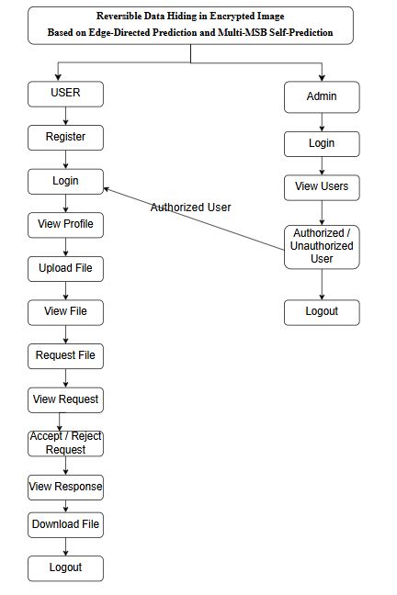
PROJECT FLOW

Slide 18
HARDWARE & SOFTWARE REQUIREMENTS
H/W CONFIGURATION:
Processor - I3/Intel Processor
Hard Disk -160GB
Key Board - Standard Windows Keyboard
Mouse - Two or Three Button Mouse
Monitor - SVGA
RAM - 4Gb

Slide 19
HARDWARE & SOFTWARE REQUIREMENTS
S/W CONFIGURATION:
Operating System : Windows 7/8/10
Server side Script :Python, HTML, MYSQL, CSS, Bootstrap.
Libraries : Django, Smtlib,Numpy
IDE : VS code
Technology : Python 3.10+

Slide 20
FUNCTIONAL AND NON-FUNCTIONAL REQUIREMENTS
Requirement’s analysis is very critical process that enables the success of a system or software project to be assessed. Requirements are generally split into two types: Functional and non-functional requirements.
Functional Requirements: These are the requirements that the end user specifically demands as basic facilities that the system should offer. All these functionalities need to be necessarily incorporated into the system as a part of the contract. These are represented or stated in the form of input to be given to the system, the operation performed and the output expected. They are basically the requirements stated by the user which one can see directly in the final product, unlike the non-functional requirements.

Slide 21
FUNCTIONAL AND NON-FUNCTIONAL REQUIREMENTS
Examples of functional requirements:
Authentication of user whenever he/she logs into the system
System shutdown in case of a cyber-attack
A verification email is sent to user whenever he/she register for the first time on some software system.
Non-functional requirements: These are basically the quality constraints that the system must satisfy according to the project contract. The priority or extent to which these factors are implemented varies from one project to other. They are also called non-behavioral requirements.

Slide 22
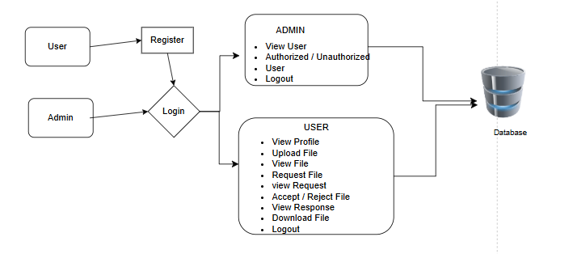
ARCHITECTURE

Slide 23
UML DIAGRAMS
USE CASE DIAGRAM:
A use case diagram in the Unified Modeling Language (UML) is a type of behavioral diagram defined by and created from a Use-case analysis. Its purpose is to present a graphical overview of the functionality provided by a system in terms of actors, their goals (represented as use cases), and any dependencies between those use cases. The main purpose of a use case diagram is to show what system functions are performed for which actor. Roles of the actors in the system can be depicted.

Slide 24
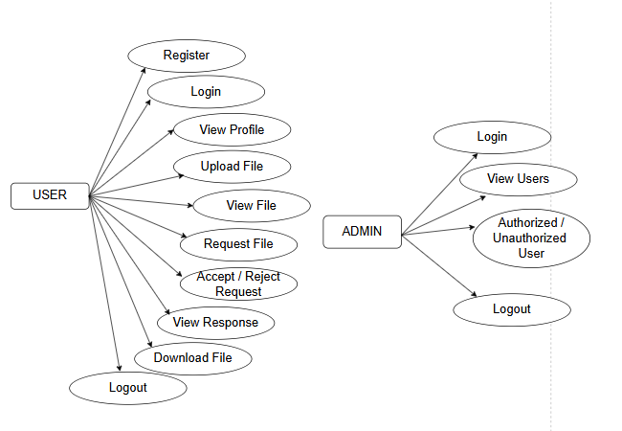

Slide 25
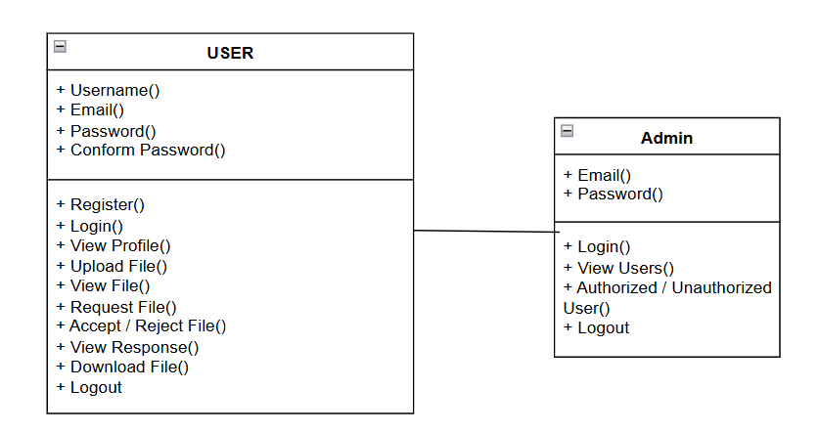
CLASS DIAGRAM:
In software engineering, a class diagram in the Unified Modeling Language (UML) is a type of static structure diagram that describes the structure of a system by showing the system's classes, their attributes, operations (or methods), and the relationships among the classes. It explains which class contains information.

Slide 26
SEQUENCE DIAGRAM:
A sequence diagram in Unified Modeling Language (UML) is a kind of interaction diagram that shows how processes operate with one another and in what order. It is a construct of a Message Sequence Chart. Sequence diagrams are sometimes called event diagrams, event scenarios, and timing diagrams.

Slide 27
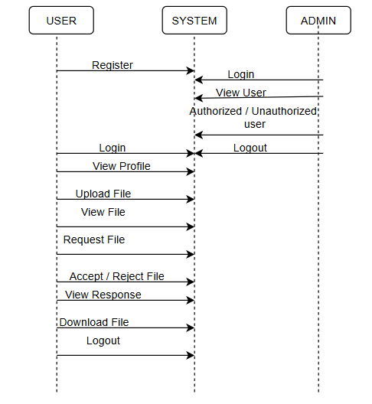

Slide 28
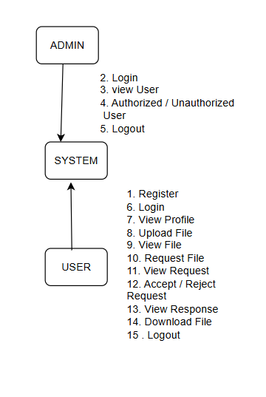
Collaboration Diagram:
In collaboration diagram the method call sequence is indicated by some numbering technique as shown below. The number indicates how the methods are called one after another. We have taken the same order management system to describe the collaboration diagram. The method calls are similar to that of a sequence diagram. But the difference is that the sequence diagram does not describe the object organization whereas the collaboration diagram shows the object organization.

Slide 29
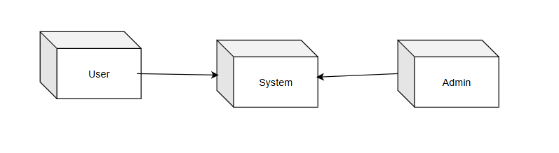
DEPLOYMENT DIAGRAM
Deployment diagram represents the deployment view of a system. It is related to the component diagram. Because the components are deployed using the deployment diagrams. A deployment diagram consists of nodes. Nodes are nothing but physical hardware’s used to deploy the application.

Slide 30
ACTIVITY DIAGRAM:
Activity diagrams are graphical representations of workflows of stepwise activities and actions with support for choice, iteration and concurrency. In the Unified Modeling Language, activity diagrams can be used to describe the business and operational step-by-step workflows of components in a system. An activity diagram shows the overall flow of control.

Slide 31
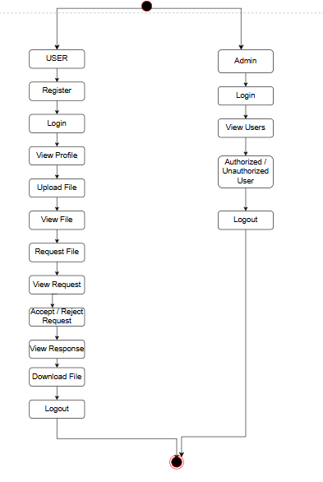

Slide 32
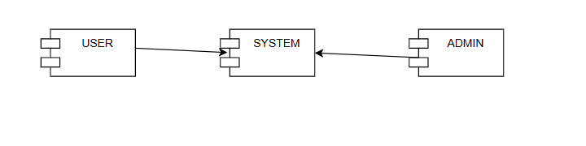
Component diagram:
A component diagram, also known as a UML component diagram, describes the organization and wiring of the physical components in a system. Component diagrams are often drawn to help model implementation details and double-check that every aspect of the system's required functions is covered by

Slide 33
ER DIAGRAM
An Entity–relationship model (ER model) describes the structure of a database with the help of a diagram, which is known as Entity Relationship Diagram (ER Diagram).
An ER diagram shows the relationship among entity sets. An entity set is a group of similar entities and these entities can have attributes.
In terms of DBMS, an entity is a table or attribute of a table in database, so by showing relationship among tables and their attributes, ER diagram shows the complete logical structure of a database.

Slide 34
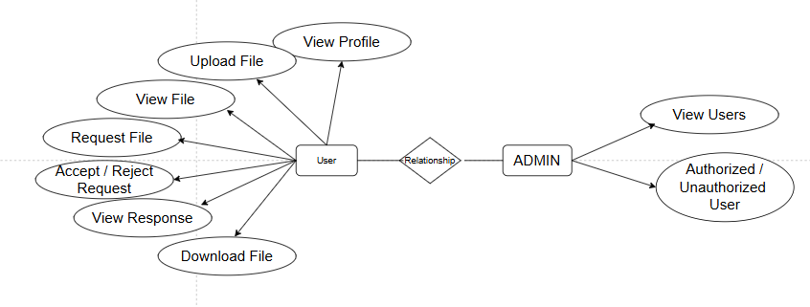

Slide 35
DFD DIAGRAM
A Data Flow Diagram (DFD) is a traditional way to visualize the information flows within a system. A neat and clear DFD can depict a good amount of the system requirements graphically. It can be manual, automated, or a combination of both. It shows how information enters and leaves the system, what changes the information and where information is stored. The purpose of a DFD is to show the scope and boundaries of a system as a whole. It may be used as a communications tool between a systems analyst and any person who plays a part in the system that acts as the starting point for redesigning a system.

Slide 36
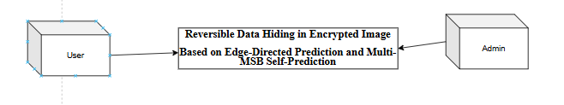
Level 0 Diagram:

Slide 37
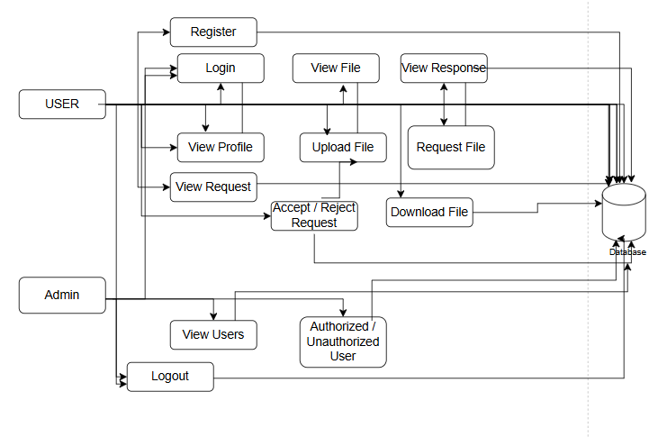
Level 1 Diagram:

Slide 38
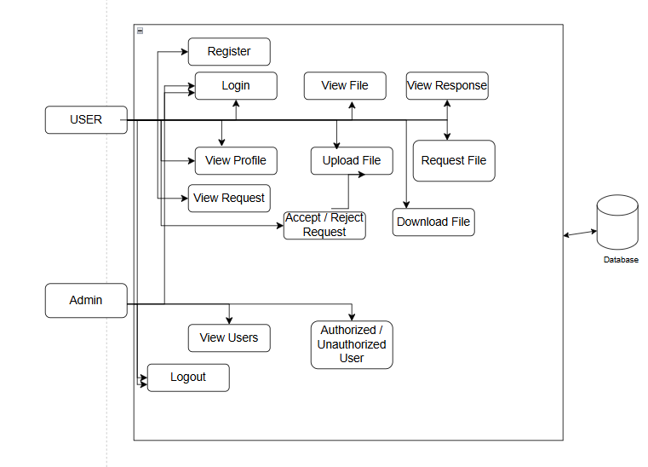
Level 2 Diagram:

Slide 39
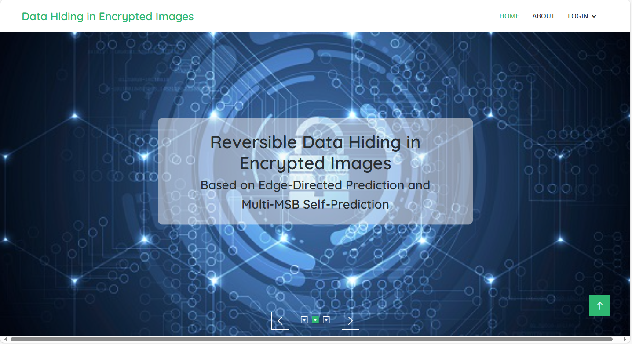
Home Page: This is the home page.

Slide 40
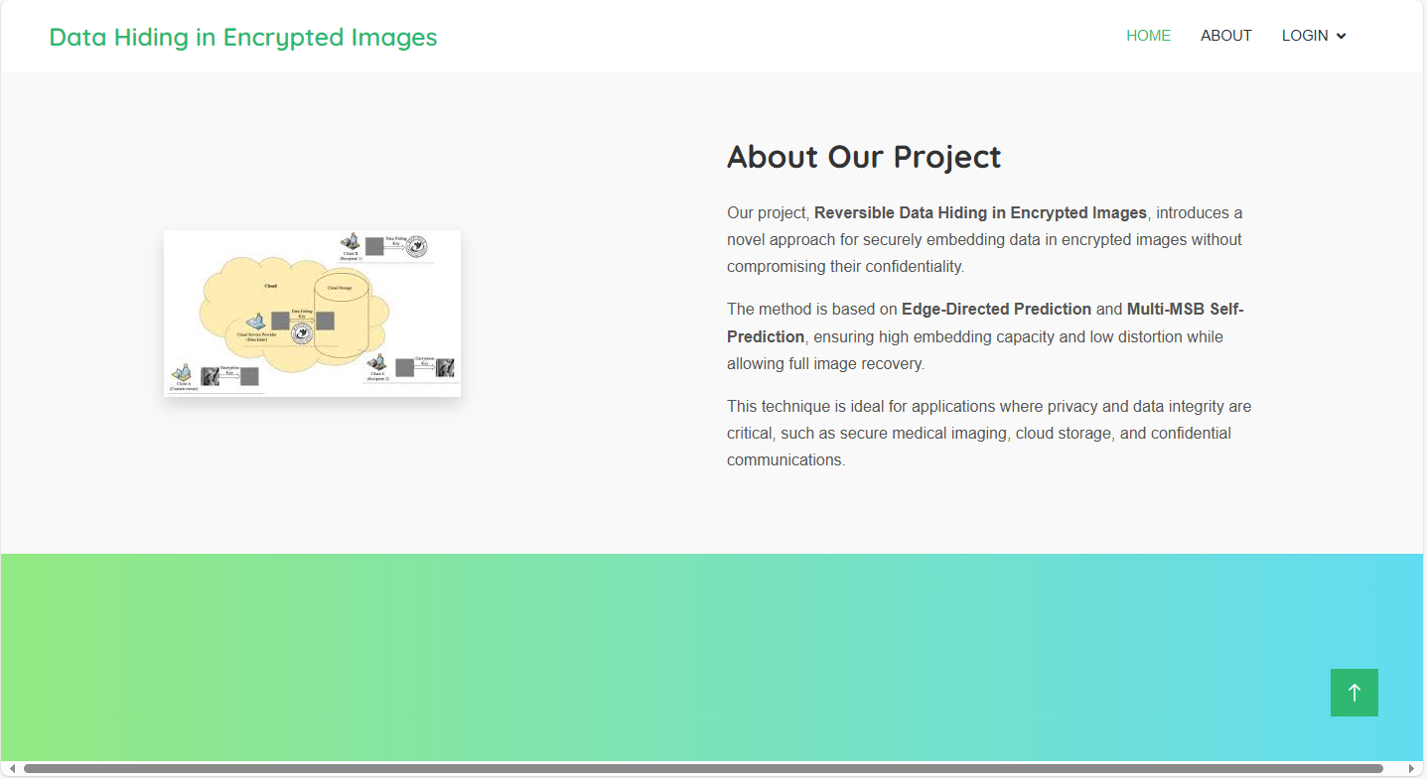
About page: here some details about project.

Slide 41
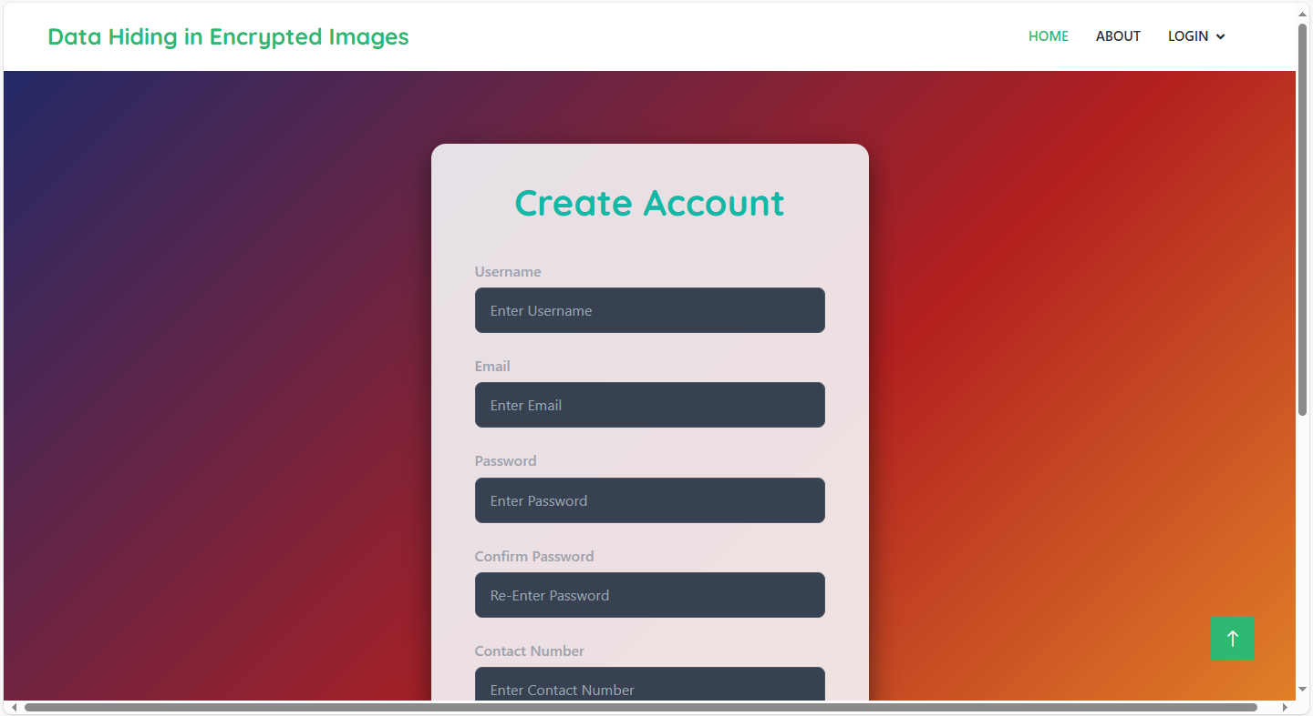
Registration Page: Here user can register by providing required details

Slide 42

Login Page: here user can login by giving their registered email and password.

Slide 43
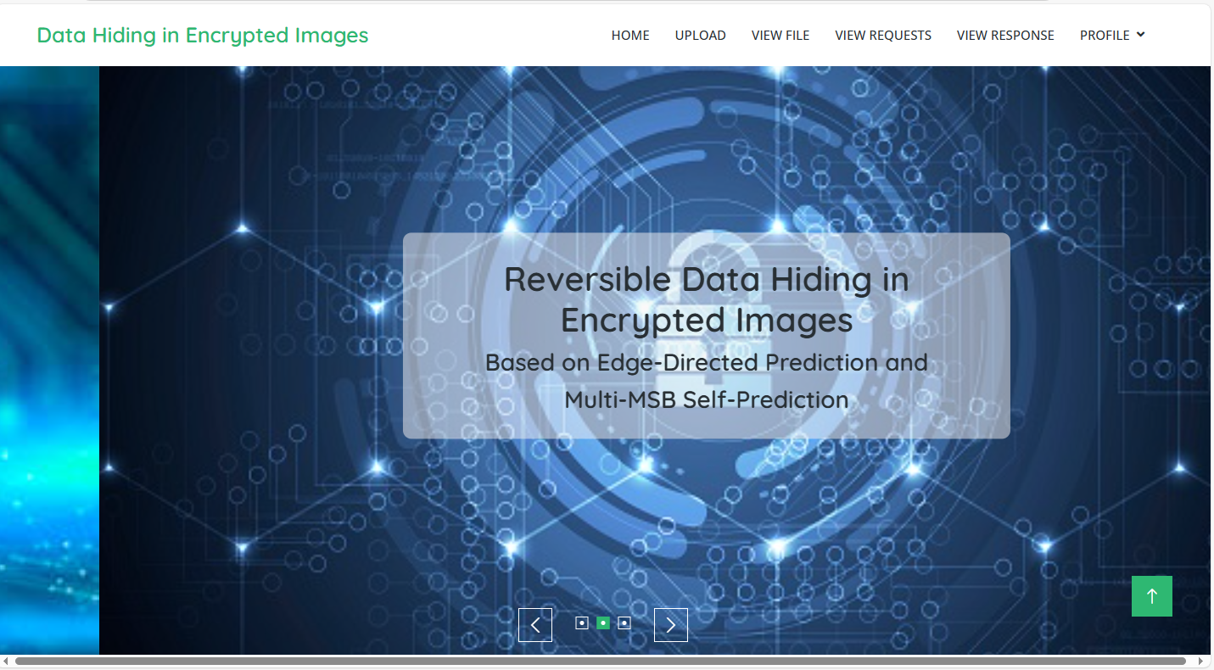
Home page: here user will redirect to home page of user when they successfully login.

Slide 44
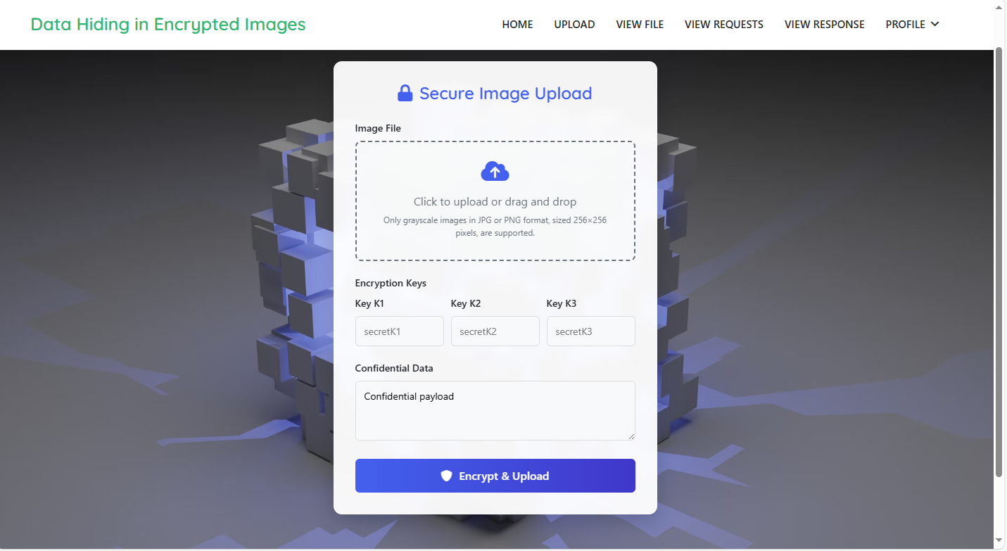
Upload File: here user can upload file with providing key and data.

Slide 45

View File: here user can view their file which are uploaded.

Slide 46
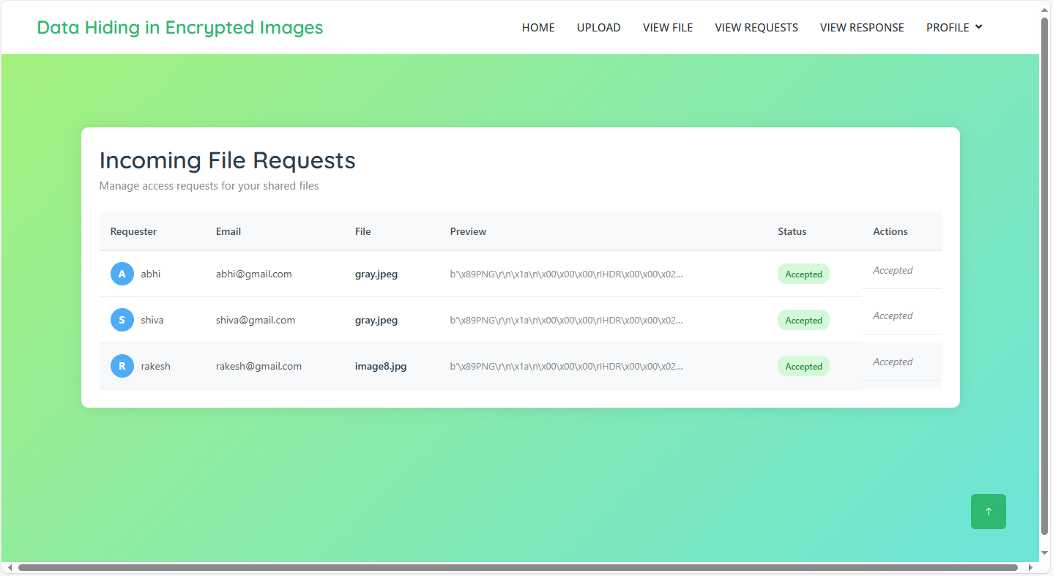
View Request: here user can view requests then they will decide accept or reject.

Slide 47

View Response: Here user can view response of requested file.

Slide 48
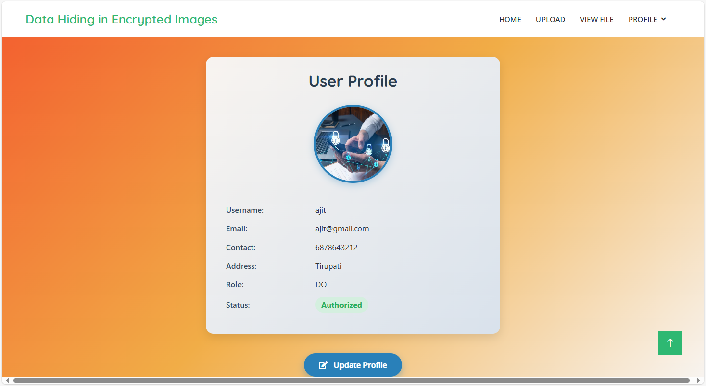
Profile: here user can view their profile later they can update.

Slide 49

Request file: here user can request the file.

Slide 50

Download page: here user can download file.

Slide 51

Admin login: here admin can login by providing details.

Slide 52
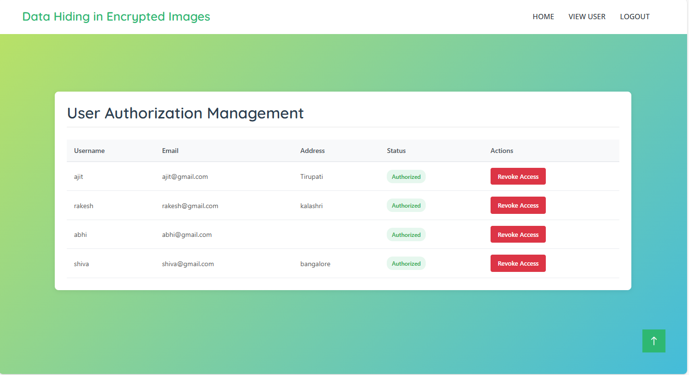
View user: here admin can view users then admin can give access to user to login to the website.

Slide 53
CONCLUSION
This project presents an advanced Reversible Data Hiding in Encrypted Images (RDH-EI) method designed to efficiently and securely embed data in encrypted grayscale images while maintaining the integrity of the original image. By employing Edge-Directed Prediction (EDP) and Multi-MSB Self-Prediction, the system enhances embedding capacity without compromising image quality or recovery accuracy. Additionally, the integration of a user authorization system with OTP verification ensures that only authorized users can access and download the data, adding an extra layer of security. Compared to existing RDH-EI techniques, this system achieves superior embedding capacity, security, and image recovery, making it well-suited for applications in cloud storage and secure communications.

Slide 54
FUTURE ENHANCEMENT
Future improvements to the system could focus on optimizing the data embedding algorithms, such as further enhancing EDP and Multi-MSB Self-Prediction techniques to achieve higher embedding capacities while preserving image quality. Real-time processing capabilities could also be introduced to facilitate dynamic environments like live streaming or real-time communication. Moreover, expanding the system to support multiple data owners and users concurrently would enhance scalability for larger datasets in cloud-based applications. Further strengthening security by incorporating additional encryption methods and multi-factor authentication could provide even more robust protection for data access. Finally, making the system compatible across various platforms and devices would ensure broader accessibility and deployment, enhancing its usability in diverse environments. These future enhancements will improve the system’s efficiency, security, and versatility, making it a more powerful solution for secure data embedding and retrieval applications.

Slide 55
REFERENCES
[1] Yingqiang Qiu, “Reversible Data Hiding in Encrypted Images Based on Edge‑Directed Prediction and Multi‑MSB Self‑Prediction,” 7 April 2025
[2] Fang Ren; Zhelin Zhang; Kai Jiang; Peiyang Zhang; Tengfei Yang, “Reversible Data Hiding and Authentication Scheme for Encrypted Images Based on Prediction Error Compression,” July 2025
[3] Huan Zhou; Guanghui Chen, “Reversible Data Hiding in Encrypted Image with Local‑Correlation‑Based Classification and Adaptive Encoding Strategy,” 2023
[4] Yiming Wang; Guoqiang Xiong; Wei He, “High‑Capacity Reversible Data Hiding in Encrypted Images Based on Pixel‑Value‑Ordering and Histogram Shifting,” 2023
[5] R. Anushiadevi; R. Amirtharajan, “Separable Reversible Data Hiding in an Encrypted Image Using the Adjacency Pixel Difference Histogram,” 2023
[6] Qingfeng Feng; Lihua Leng; Chun‑Chieh Chang; Jun‑Hong Horng; Meng‑Hsuan Wu, “Reversible Data Hiding in Encrypted Images with Extended Parametric Binary Tree Labeling,” 2023

Slide 56
REFERENCES
[7] Princy Jeena; R. Shreelekshmi, “High Capacity Reversible Data Hiding in Encrypted Images Using Block Labeling,” 2023
[8] P. V. Deshmukh; A. S. Kapse; V. M. Thakare; A. S. Kapse, “High Capacity Reversible Data Hiding in Encrypted Images Using Multi‑MSB Data Hiding Mechanism with Elliptic Curve Cryptography,” 2023
[9] C. Y. Weng; C. H. Yang, “Reversible Data Hiding in Encrypted Image Using Multiple Data‑Hiders Sharing Algorithm,” 2023
[10] Shao‑Ying Xu; Chun‑Chieh Chang; Jun‑Wei Horng, “A Steganography Based on Optimal Multi‑Threshold Block Labeling,” 2022
[11] Zehua Hua; Yuxuan Wang; Shengyi Yi; Yong Zhou; Xin Jia, “Reversible Data Hiding in Encrypted Images Using Cipher‑Feedback Secret Sharing,” August 2022
[12] Zehua Hua; Yuxuan Wang; Shengyi Yi; Yichen Zheng; Xiaoyue Liu; Ying Chen; Xiaobo Zhang, “Matrix‑Based Secret Sharing for Reversible Data Hiding in Encrypted Images,” September 2023

